Slide 1
DEVELOPING YOUR BRAND
Nicole Palidwor
Outcomes Career Coach

Slide 2
LEARNING OBJECTIVES
DEVELOPING YOUR BRAND
Identify what a brand statement is and how it can be used in the job search process
Explain the importance of having a strong professional brand
Develop a working version of their brand statement
Notes:
Defining your voice and discovering your brand is critical in the job search success story!

Slide 3
DEVELOPING YOUR BRAND
LET’S GET STARTED!

Slide 4
DEVELOPING YOUR BRAND
TELL ME ABOUT YOURSELF.

Slide 5
DEVELOPING YOUR BRAND
2 paths: Interrogation vs. Dialog
If answered well, tell me more. [Dialog]
If you’re not being relevant, there will be more questions to figure out what’s going on. Are you qualified? Are you legit? [Interrogation]

Slide 6
DEVELOPING YOUR BRAND
Our job today is to answer this question in a way that’s powerful.

Slide 7
DEVELOPING YOUR BRAND
BRANDING 101

Slide 8
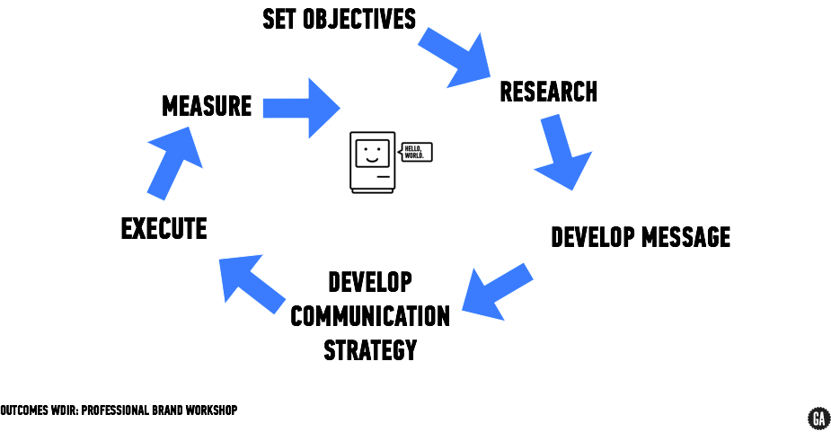
BRANDING 101

Slide 9
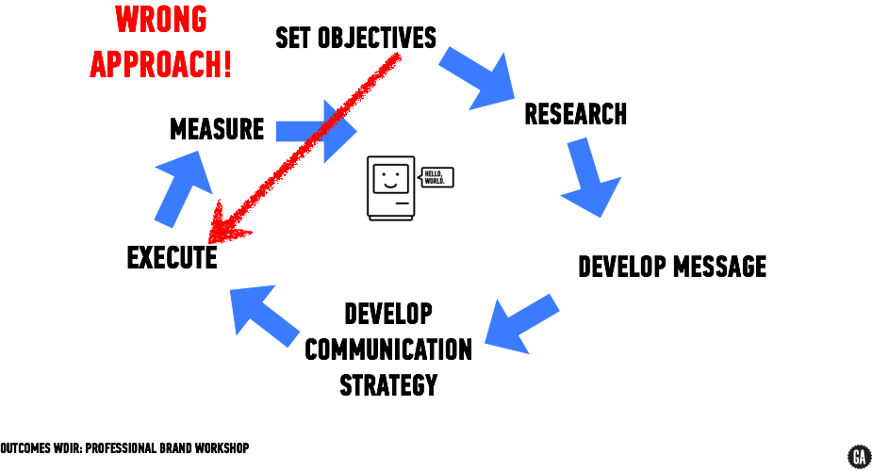
BRANDING 101

Slide 10

BRANDING 101

Slide 11

BRANDING 101

Slide 12
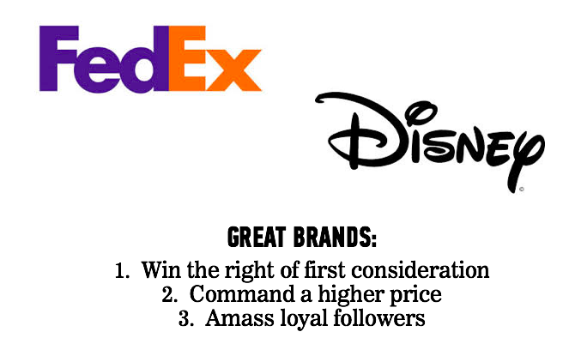
BRANDING 101

Slide 13
BRANDING 101
Wouldn’t it be nice if you were on the top of mind of hiring managers?
Wouldn't it be nice if you could command a higher price?
Wouldn’t it be nice if you had loyal followers who were interested in what you were doing or what you had to say?

Slide 14
DEVELOPING YOUR BRAND
WHAT’S A PERSONAL BRAND STATEMENT?

Slide 15
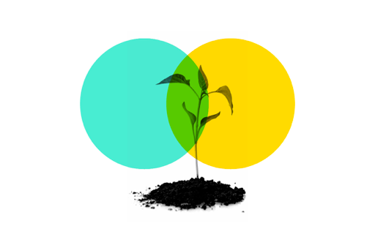
A good brand statement strategically communicates who you are professionally.
Think of it like a professional thesis statement.
BRAND STATEMENT

Slide 16
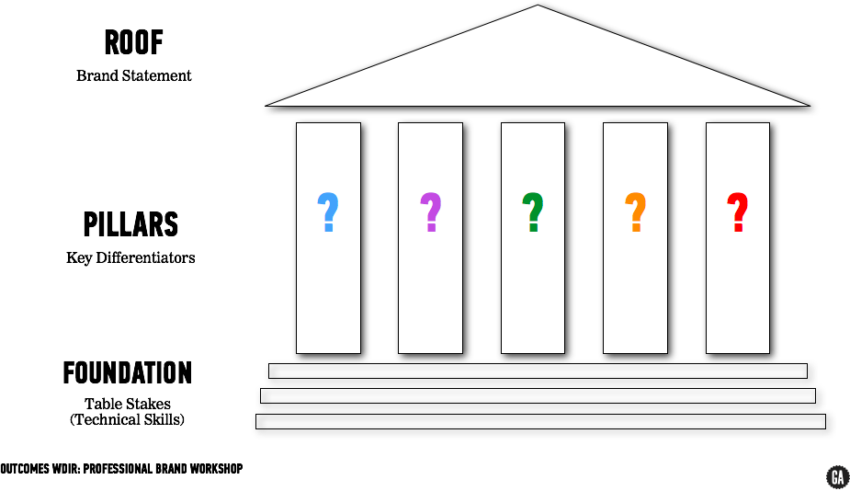
BRAND STATEMENT

Slide 17
BRAND STATEMENT
Your brand statement answers 4 questions:
What do you do?
What problem do you solve?
How are you different?
Why should anyone care?

Slide 18
BRAND STATEMENT
3 places to use your brand statement:
LinkedIn Profile Summary [longer form]
Resume [short + professional]
In Person [short, easy concepts]

Slide 19
DEVELOPING YOUR BRAND
PURPOSE OF BRAND STATEMENT

Slide 20

PURPOSE
Your brand is what separates you from everyone else and highlights your differentiators and marketable qualities.
This is the way you want yourself to be perceived by others and also how you want to live your professional life.
Your brand also sets the tone for what potential employers can expect from you and becomes a jumping off point for conversations, interviews, cover letters, and your resume.

Slide 21

ACTIVITY: IMPORTANCE OF A BRAND
DIRECTIONS
EXERCISE
Get with a partner
Take 5 minutes to discuss a mentor, friend, celebrity - someone who immediately comes to mind because they have a strong brand. Discuss why that person stood out to you and/or why you were drawn to them.

Slide 22
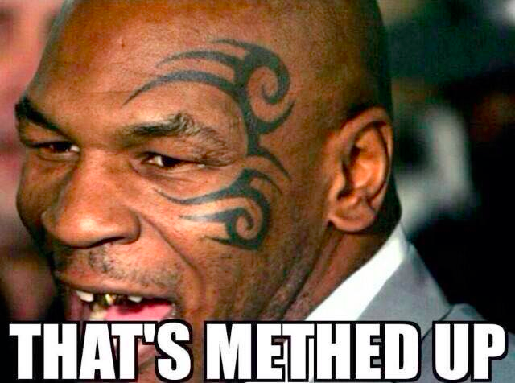
PURPOSE
It’s not a face tattoo...it may change and most likely will change, even by the end of this course.

Slide 23
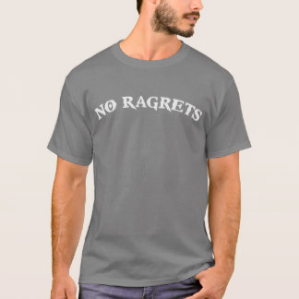
PURPOSE
But it’s important! This statement
is the foundation of the rest of your
communication strategy (resume,
LinkedIn, etc.) and represents
who you are.

Slide 24
DEVELOPING YOUR BRAND
EXERCISE:
WHAT’S YOUR STORY

Slide 25
WHAT’S YOUR STORY?
INTERVIEWER
CANDIDATE
SCRIBE
BREAK OUT INTO GROUPS OF 3.
ASSIGN EACH PERSON A ROLE.
5 MINUTES EACH, THEN WE’LL ROTATE.

Slide 26
INTERVIEW QUESTIONS
What were you doing before GA?
Why are you here?
What are your goals post-course?
What does your ideal career look like?
What type of environment do you thrive in?
How do you solve problems?
What motivates you?
What are a few of your hobbies?
What gives you joy?
What makes you unique?

Slide 27
DEVELOPING YOUR BRAND
DISTILLING IT DOWN

Slide 28
NARROWING DOWN THE LIST
RELEVANCE
RESULTS
BENEFITS

Slide 29
NARROWING DOWN THE LIST
Remember: Writing a brand statement is hard. It’s a process that takes time and thought.
If you’re getting stuck, try starting with a paragraph and focus on communicating what you want say. Then distill it down into a tighter and shorter statement.

Slide 30
DEVELOPING YOUR BRAND
EXAMPLES FROM
GA ALUMNI

Slide 31
EXAMPLES
EXAMPLES FROM GA ALUMNI
“UX Designer driven by empathy and simplicity. My design skills and background in marketing, project management, front-end development, and content production allow me to craft thoughtful solutions that enhance people’s lives.”
-- PAT YAU
“I love bringing human connection and breathing life into the backlit screens we stare at every day. I’m a feeler. I’m a visual-thinker. I dive head-first. Craftsmanship is a key element in my work and I am a firm believer that if you approach every situation with empathy and compassion, the rest will fall into place.”
-- KATIE HUDAK

Slide 32
EXAMPLES
EXAMPLES FROM GA ALUMNI
“I am deeply curious and driven by the opportunity to create and share simple solutions to complex problems. From building LEGOs and skateboard ramps to optimizing pharmaceutical and industrial manufacturing — my creative and inquisitive nature is constantly evolving.The skills and interests I developed as a client-facing process engineer has instilled in me a passion to create tools that will help others.”
-- TOMMY LIM
“I move with the rhythm of users to create intuitive designs that emphasize simplicity, community, and excitement. As a trained scientist, I bring an analytical mind that is thoughtful to both data and users alike for attractive, engaging design.”
-- JOHN WILLIS

Slide 33
EXAMPLES
EXAMPLES FROM GA ALUMNI
“Full-stack web developer and dancer who enjoys finding creative solutions for out of the ordinary problems. Passionate and inspired by visual aesthetics, good design, and clean, precise code. Driven to create interactive products shaped around human experience, expression, and intuitive, efficient functionality.”
-- JAMIE KARLOVICH
“I am a creative-minded, solutions-driven software developer with a passion for intuitive design and function. My previous experience as a full-time touring musician informs everything that I do: from my ability to adapt and adjust plans quickly to finding efficient, concise solutions for challenging problems.”
-- BRENT RUSINOW

Slide 34
DEVELOPING YOUR BRAND
Q & A

Slide 35
DEVELOPING YOUR BRAND
HOMEWORK

Slide 36
HOMEWORK
Continue to work on your brand statement rough draft. Due next week and submitted to the Toolkit. Use these resources to help in building your brand statement:
Outcomes Student Action Plan: What’s My Brand? Worksheet
Free Personality Test
Utilize the LinkedIn checklist to update your LinkedIn and add customized url to the Toolkit.
Use Built in Austin, LinkedIn, The Muse & other online resources to compile a list of 10 companies you are interested in. Add them to your personal job tracker.
Sign up for your first 1:1 with your coach [if you haven’t done so already]

